Slide 1
Implementing the Least Privilege Principle in Security
Minimizing Risk by Restricting Access
By: Curtis Crawford
Notes:
Good day, everyone. For those of you that don’t know me, which is most of you, name is Curtis Crawford, and I’m here from Lighthouse Labs, where I’m wrapping up my studies in cybersecurity with the goal of graduating soon and launching my career in this field. Today, I’ll be talking about a critical concept in cybersecurity—the principle of least privilege. This principle, though straightforward, plays a key role in protecting systems by limiting access to what’s absolutely necessary. Let’s dive into how it works and why it’s so important.

Slide 2

The Stuck Elevator Incident
Notes:
Imagine this scenario: a company hires a new junior employee in the IT department. On their first day, they’re given unrestricted access to the entire network to help them 'get familiar' with the system. While exploring, they accidentally misconfigure settings on a shared drive. This small, innocent mistake causes disruptions in the system, including the building's control panel, which, unknown to them, is also tied to the company’s elevator access. By the end of the day, employees were locked in an elevator for two hours! A single point of access oversight led to unnecessary inconvenience and cost – all because one person had too much access. This is just a quick example of why implementing the principle of least privilege is crucial.

Slide 3
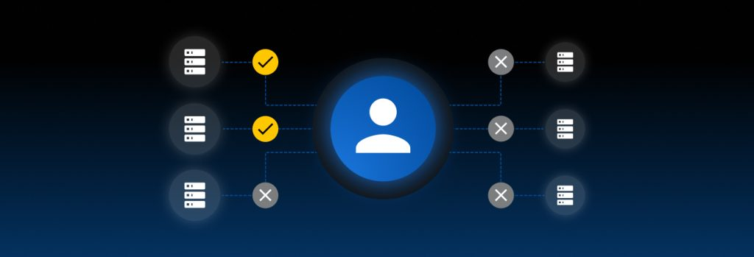
What is the Least Privilege Principle?
Definition: Granting only the minimum access necessary for users to perform their job functions.
Goal: Limit exposure to sensitive systems and data, reducing potential points of compromise.
Notes:
So what is the least privilege principle? Well, the privilege of least principle is granting only the minimum access necessary for users to perform their job functions. And the goal is to limit the exposure of users to sensitive systems and data which will reduce potential points of compromise. The least privilege principle is a core security concept that ensures employees have just enough access to perform their duties. This minimizes the risk of accidental or intentional data breaches, keeping systems and data secure.

Slide 4
Why is Least Privilege Important?
Prevents unauthorized access
Reduces potential damage from insider threats
Limits the scope of attack vectors
Notes:
I’m sure after our quick story at the beginning of this presentation, you might have an idea as to why the principle of least privilege is important, but let’s look at some of the key concepts.
Some of the benefits of the principle least privilege is that it: Prevents unauthorized access.
It reduces potential damage from insider threats.
& it limits the scope of attack vectors.
By implementing least privilege, we reduce the 'blast radius' in case of a mistake or attack. The more privileges someone has, the greater the potential impact if their credentials are compromised or if they make an error.

Slide 5
How to Implement Least Privilege
Access Controls: Use role-based access control (RBAC) to assign permissions based on job roles.
Regular Audits: Review access regularly to ensure compliance.
Granular Permissions: Break down permissions to ensure users only access what’s necessary.
Notes:
Implementing least privilege requires structured access control, regular audits, and creating granular permissions. With access controls we can use a role based methodology to assign permissions based on job roles.
Regular audits allow us to review access to continuously ensure compliance.
& granular permissions are how we break down permissions to ensure users only access what’s necessary. These methods can help to prevent what’s known as ‘privilege creep,’ where employees gradually accumulate more access than necessary over time.

Slide 6
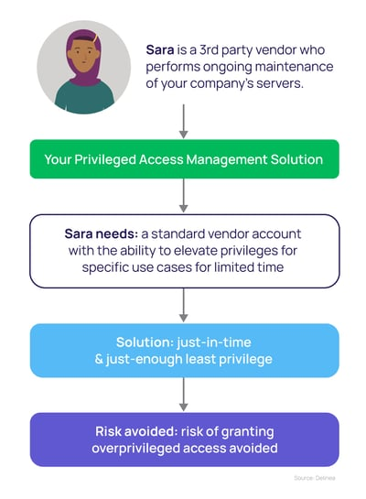
Least Privilege in Action:
https://delinea.com/blog/principle-of-least-privilege-examples
Notes:
“According to the Principle of Least Privilege, vendors should never have broad admin rights on your network. This is especially true if you don't manage the devices vendors use to access your network.
As a starting point, third-party vendor credentials should always be limited in terms of time and scope. Rather than providing blanket privileges, have vendors log in using a standard vendor account and provide a mechanism to elevate their privileges for specific use cases or applications only, and for a limited time. Any elevation to privileged access should be just-enough (JEP) and just-in-time (JIT).
Any user accessing your network using vendor credentials should be subjected to an “always verify and always monitor” policy. “Always verifying” means that each time a vendor attempts to access a resource on your network, they are forced to authenticate using Multi-Factor Authentication (MFA). That also goes for subsequent access to other resources or privilege elevation.
An “always monitor” policy ensures that all actions a vendor takes are recorded by default, and available for later audit or review.” - https://delinea.com/blog/principle-of-least-privilege-examples#:~:text=Other%20least%20privilege%20examples%20to,as%20scanning%20all%20email%20attachments.

Slide 7
Final Takeaways
The least privilege principle is foundational in security.
Effective implementation requires vigilance and regular updates.
It’s about balancing access with security needs.
Notes:
Lastly, let’s take a look at our final takeaways. The least privilege principle is foundational in security. It’s effective implementation is one that requires vigilance and regular updates.
& it’s about balancing access, with security needs. Ultimately, implementing the least privilege principle is about managing risk. By granting access thoughtfully and with purpose, organizations create a more resilient security posture.

Slide 8
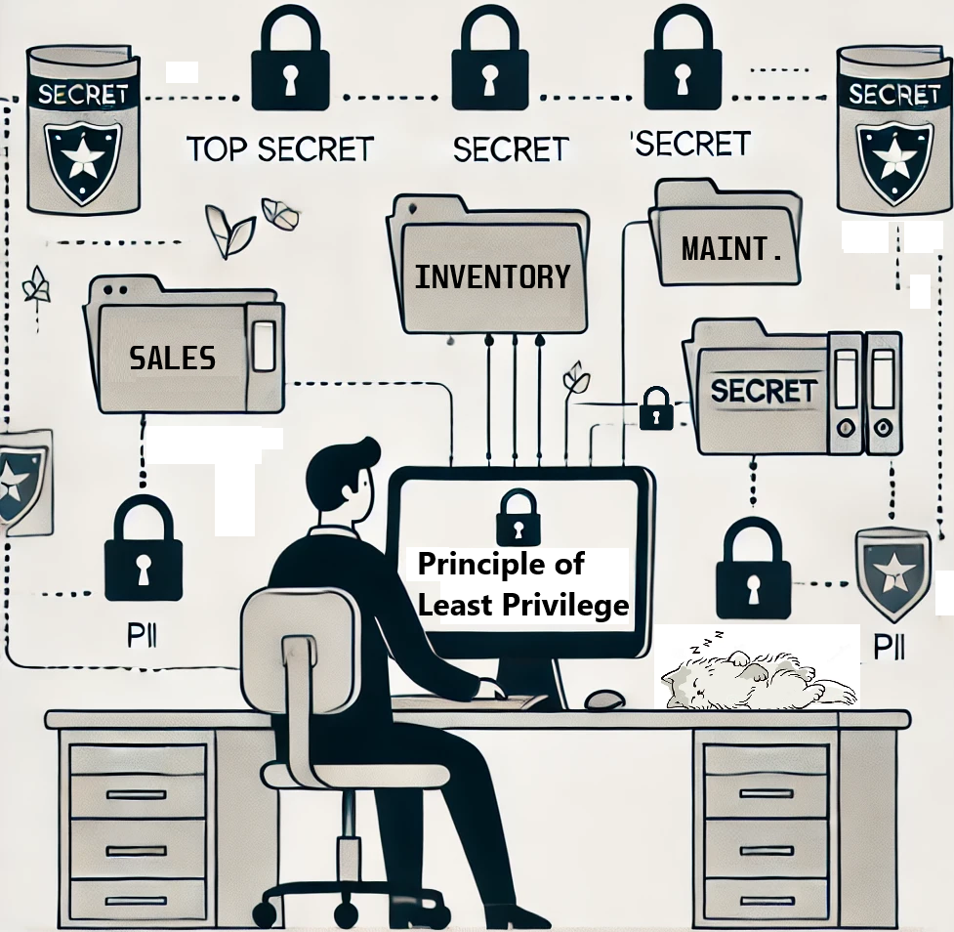
Thank you!
Any questions?
Notes:
As we’ve seen, the principle of least privilege isn’t just a guideline; it’s a fundamental part of reducing risk and maintaining security. By ensuring that access is limited to only what’s essential, we not only protect sensitive information but also strengthen our overall security posture. Implementing least privilege is a proactive way to minimize potential damage and keep our systems resilient. Thank you for your attention, and let’s remember that sometimes, the simplest restrictions can make the biggest difference. Any questions?

